Slide 1

Tree Traversal
Asra Masood
Department of Creative Technologies
Air University Islamabad

Slide 2
Outline
This topic will cover tree traversals:
  A means of visiting all the objects in a tree data structure
  We will look at
    Breadth-first traversals
    Depth-first traversals
  Applications

Slide 3
Background
All the objects stored in an array or linked list can be accessed sequentially
When discussing deques, we introduced iterators in C++:
  These allow the user to step through all the objects in a container
Question: how can we iterate through all the objects in a tree in a predictable and efficient manner
  Requirements: Θ(n) run time and o(n) memory
Notes:
3

Slide 4
Types of Traversals
We have already seen one traversal:
  The breadth-first traversal visits all nodes at depth k before proceeding onto depth k + 1
  Easy to implement using a queue
Another approach is to visit always go as deep as possible before visiting other siblings: depth-first traversals

Slide 5
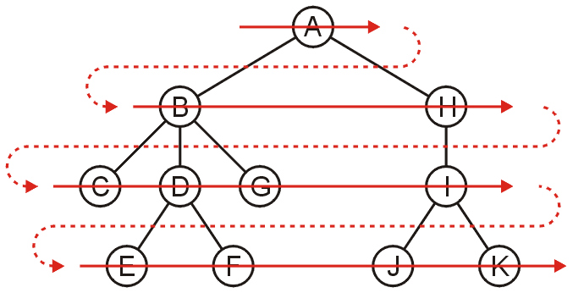
Breadth-First Traversal
Breadth-first traversals visit all nodes at a given depth
  Can be implemented using a queue
  Order: A B H C D G I E F J K

Slide 6
Breadth-First Traversal
The implementation was already discussed:
  Create a queue and push the root node onto the queue
  While the queue is not empty:
    Push all of its children of the front node onto the queue
    Pop the front node

Slide 7
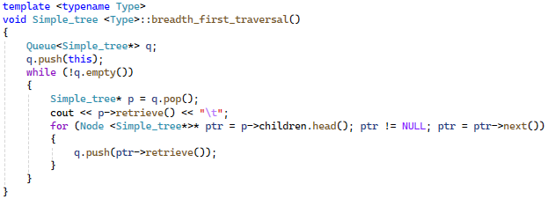
Breadth-First Traversal
The implementation was already discussed:

Slide 8
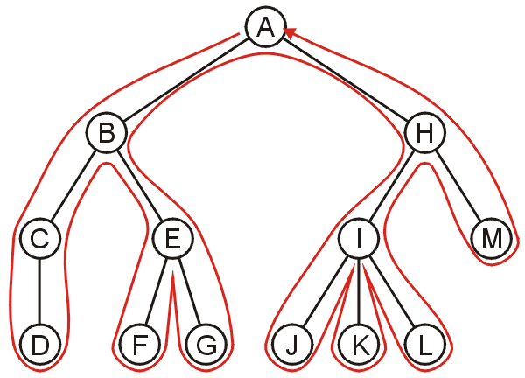
Backtracking
To discuss depth-first traversals, we will define a backtracking algorithm for stepping through a tree:
  At any node, we proceed to the first child that has not yet been visited
  Or, if we have visited all the children (of which a leaf node is a special case), we backtrack to the parent and repeat this decision making process
We end once all the children
of the root are visited

Slide 9
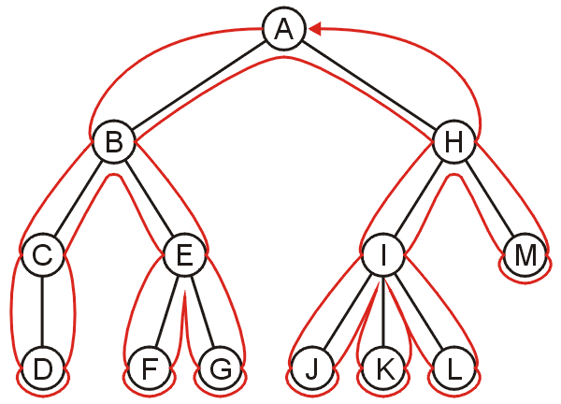
Depth-first Traversal
We define such a path as a depth-first traversal
We note that each node could be visited twice in such a scheme
  The first time the node is approached (before any children)
  The last time it is approached (after all children)

Slide 10
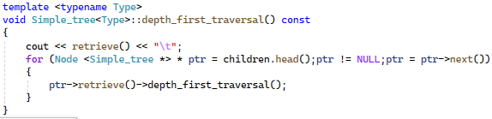
Implementing depth-first traversals
Depth-first traversals can be implemented with recursion:

Slide 11
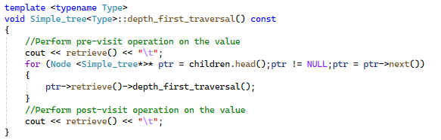
Implementing depth-first traversals
Pre-visit and post-visit with recursion:

Slide 12
Implementing depth-first traversals
Alternatively, we can use a stack:
  Create a stack and push the root node onto the stack
  While the stack is not empty:
    Pop the top node
    Push all of the children of that node to the top of the stack in reverse order
  Run time is Θ(n)
  The objects on the stack are all unvisited siblings from the root to the current node
    If each node has a maximum of two children, the memory required is Θ(h): the height of the tree
With the recursive implementation, the memory is Θ(h): recursion just hides the memory
Notes:
12

